Slide 1

Data Analysis
A.A. 2021/2022
Statistical Methods and Models
Prof. David Barilla
Email: dbarilla@unime.it

Slide 2
Probability Theory
Probability – Models for random phenomena

Slide 3
Phenomena
Non-deterministic
Deterministic

Slide 4
Deterministic Phenomena
There exists a mathematical model that allows “perfect” prediction the phenomena’s outcome.
Many examples exist in Physics, Chemistry (the exact sciences).
Non-deterministic Phenomena
No mathematical model exists that allows “perfect” prediction the phenomena’s outcome.

Slide 5
Non-deterministic Phenomena
may be divided into two groups.
Random phenomena
  Unable to predict the outcomes, but in the long-run, the outcomes exhibit statistical regularity.
Haphazard phenomena
  unpredictable outcomes, but no long-run, exhibition of statistical regularity in the outcomes.

Slide 6
Phenomena
Non-deterministic
Deterministic
Haphazard
Random

Slide 7
Haphazard phenomena
  unpredictable outcomes, but no long-run, exhibition of statistical regularity in the outcomes.
  Do such phenomena exist?
  Will any non-deterministic phenomena exhibit long-run statistical regularity eventually?

Slide 8
Random phenomena
  Unable to predict the outcomes, but in the long-run, the outcomes exhibit statistical regularity.
Examples
Tossing a coin – outcomes S ={Head, Tail}
Unable to predict on each toss whether is Head or Tail.
In the long run can predict that 50% of the time heads will occur and 50% of the time tails will occur

Slide 9
Rolling a die – outcomes
S ={ , , , , , }
Unable to predict outcome but in the long run can one can determine that each outcome will occur 1/6 of the time.
Use symmetry. Each side is the same. One side should not occur more frequently than another side in the long run. If the die is not balanced this may not be true.

Slide 10
Definitions

Slide 11
The sample Space, S
The sample space, S, for a random phenomena is the set of all possible outcomes.

Slide 12
Examples
Tossing a coin – outcomes S ={Head, Tail}
Rolling a die – outcomes
S ={ , , , , , }
={1, 2, 3, 4, 5, 6}

Slide 13
An Event , E
The event, E, is any subset of the sample space, S. i.e. any set of outcomes (not necessarily all outcomes) of the random phenomena
Venn diagram
S
E

Slide 14
The event, E, is said to have occurred if after the outcome has been observed the outcome lies in E.
S
E

Slide 15
Examples
Rolling a die – outcomes
S ={ , , , , , }
={1, 2, 3, 4, 5, 6}
E = the event that an even number is rolled
= {2, 4, 6}
={ , , }

Slide 16
Special Events
The Null Event, The empty event - φ
φ = { } = the event that contains no outcomes
The Entire Event, The Sample Space - S
S = the event that contains all outcomes
The empty event, φ , never occurs.
The entire event, S, always occurs.

Slide 17
Set operations on Events
Union
Let A and B be two events, then the union of A and B is the event (denoted by A∪B) defined by:
A ∪ B = {e| e belongs to A or e belongs to B}
A ∪ B
A
B

Slide 18
The event A ∪ B occurs if the event A occurs or the event and B occurs .
A ∪ B
A
B

Slide 19
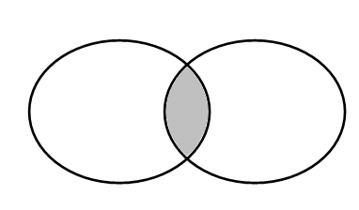
Intersection
Let A and B be two events, then the intersection of A and B is the event (denoted by A∩B) defined by:
A ∩ B = {e| e belongs to A and e belongs to B}
A ∩ B
A
B

Slide 20
The event A ∩ B occurs if the event A occurs and the event and B occurs .
A ∩ B
A
B

Slide 21

Complement
Let A be any event, then the complement of A (denoted by ) defined by:
= {e| e does not belongs to A}
A

Slide 22
The event occurs if the event A does not occur
A

Slide 23
In problems you will recognize that you are working with:
Union if you see the word or,
Intersection if you see the word and,
Complement if you see the word not.

Slide 24
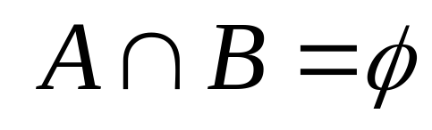
Definition: mutually exclusive
Two events A and B are called mutually exclusive if:
A
B

Slide 25
If two events A and B are are mutually exclusive then:
They have no outcomes in common.
They can’t occur at the same time. The outcome of the random experiment can not belong to both A and B.
A
B

Slide 26
Probability

Slide 27
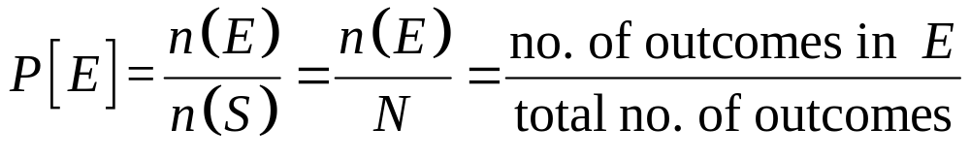
Definition: probability of an Event E.
Suppose that the sample space S = {o₁, o₂, o₃, … o_{N}} has a finite number, N, of oucomes.
Also each of the outcomes is equally likely (because of symmetry).
Then for any event E

Slide 28
Thus this definition of P[E], i.e.
Applies only to the special case when
The sample space has a finite no.of outcomes, and
Each outcome is equi-probable
If this is not true a more general definition of probability is required.

Slide 29
Rules of Probability

Slide 30
Rule The additive rule
(Mutually exclusive events)
P[A ∪ B] = P[A] + P[B]
i.e.
P[A or B] = P[A] + P[B]
if A ∩ B = φ
(A and B mutually exclusive)

Slide 31
If two events A and B are are mutually exclusive then:
They have no outcomes in common.
They can’t occur at the same time. The outcome of the random experiment can not belong to both A and B.
A
B

Slide 32
P[A ∪ B] = P[A] + P[B]
i.e.
P[A or B] = P[A] + P[B]
A
B

Slide 33
Rule The additive rule
(In general)
P[A ∪ B] = P[A] + P[B] – P[A ∩ B]
or
P[A or B] = P[A] + P[B] – P[A and B]

Slide 34




Logic
When P[A] is added to P[B] the outcome in A ∩ B are counted twice
hence
P[A ∪ B] = P[A] + P[B] – P[A ∩ B]

Slide 35
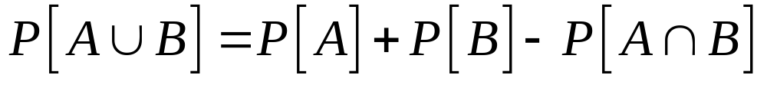
Example:
Saskatoon and Moncton are two of the cities competing for the World university games. (There are also many others). The organizers are narrowing the competition to the final 5 cities.
There is a 20% chance that Saskatoon will be amongst the final 5. There is a 35% chance that Moncton will be amongst the final 5 and an 8% chance that both Saskatoon and Moncton will be amongst the final 5. What is the probability that Saskatoon or Moncton will be amongst the final 5.

Slide 36

Solution:
Let A = the event that Saskatoon is amongst the final 5.
Let B = the event that Moncton is amongst the final 5.
Given P[A] = 0.20, P[B] = 0.35, and P[A ∩ B] = 0.08
What is P[A ∪ B]?
Note: “and” ≡ ∩, “or” ≡ ∪ .

Slide 37
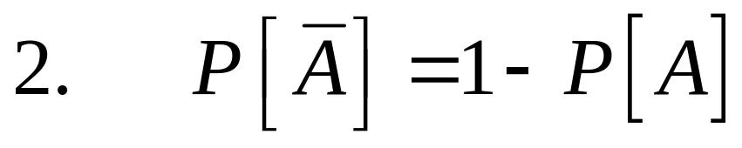
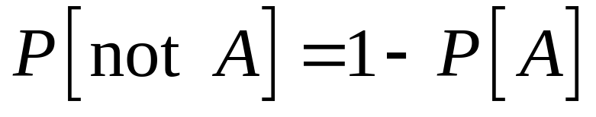
Rule for complements
or

Slide 38
Complement
Let A be any event, then the complement of A (denoted by ) defined by:
= {e| e does not belongs to A}
A

Slide 39
The event occurs if the event A does not occur
A

Slide 40
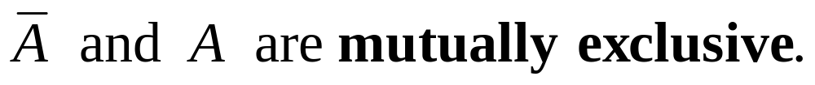
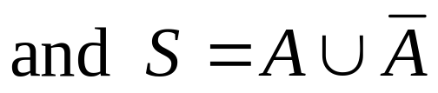
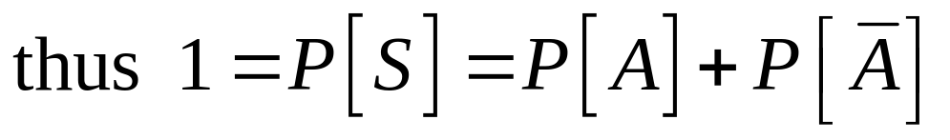
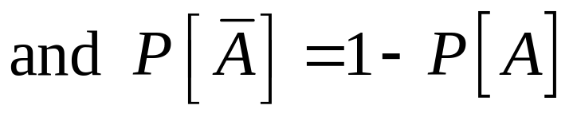
Logic:
A

Slide 41
Conditional Probability

Slide 42
Conditional Probability
Frequently before observing the outcome of a random experiment you are given information regarding the outcome
How should this information be used in prediction of the outcome.
Namely, how should probabilities be adjusted to take into account this information
Usually the information is given in the following form: You are told that the outcome belongs to a given event. (i.e. you are told that a certain event has occurred)

Slide 43
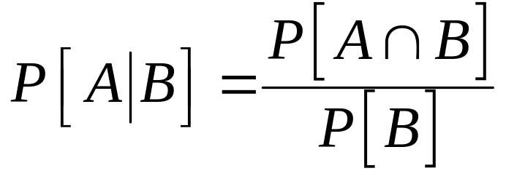
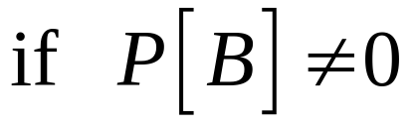
Definition
Suppose that we are interested in computing the probability of event A and we have been told event B has occurred.
Then the conditional probability of A given B is defined to be:

Slide 44
Rationale:
If we’re told that event B has occurred then the sample space is restricted to B.
The probability within B has to be normalized, This is achieved by dividing by P[B]
The event A can now only occur if the outcome is in of A ∩ B. Hence the new probability of A is:
A
B
A ∩ B

Slide 45
An Example
The academy awards is soon to be shown.
For a specific married couple the probability that the husband watches the show is 80%, the probability that his wife watches the show is 65%, while the probability that they both watch the show is 60%.
If the husband is watching the show, what is the probability that his wife is also watching the show

Slide 46
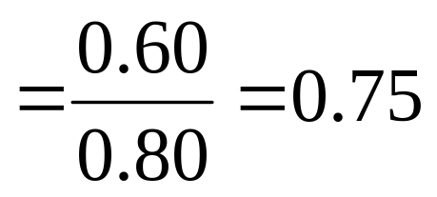
Solution:
The academy awards is soon to be shown.
Let B = the event that the husband watches the show
P[B]= 0.80
Let A = the event that his wife watches the show
P[A]= 0.65 and P[A ∩ B]= 0.60

Slide 47
Independence

Slide 48
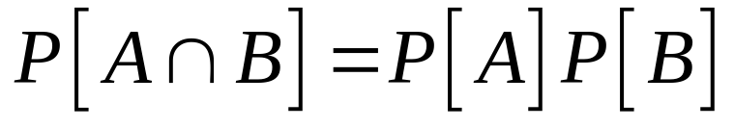
Definition
Two events A and B are called independent if

Slide 49
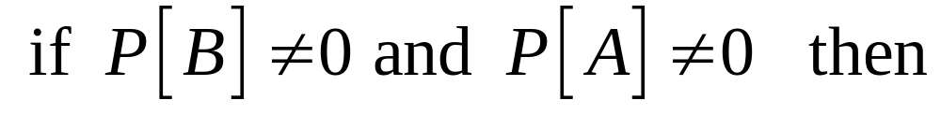
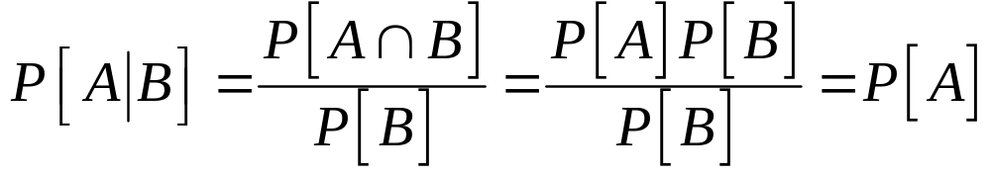
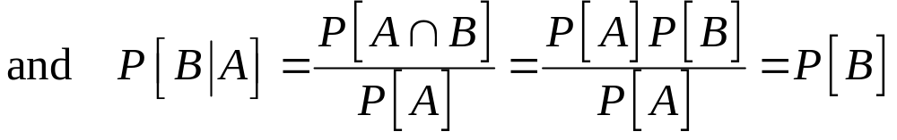
Note
Thus in the case of independence the conditional probability of an event is not affected by the knowledge of the other event

Slide 50
Difference between independence and mutually exclusive
mutually exclusive
Two mutually exclusive events are independent only in the special case where
Mutually exclusive events are highly dependent otherwise. A and B cannot occur simultaneously. If one event occurs the other event does not occur.
A
B

Slide 51
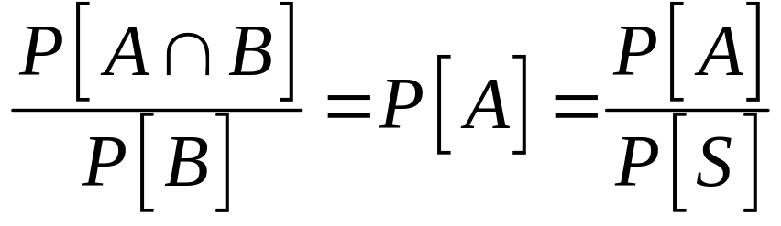

Independent events
or
S
B
A
The ratio of the probability of the set A within B is the same as the ratio of the probability of the set A within the entire sample S.

Slide 52
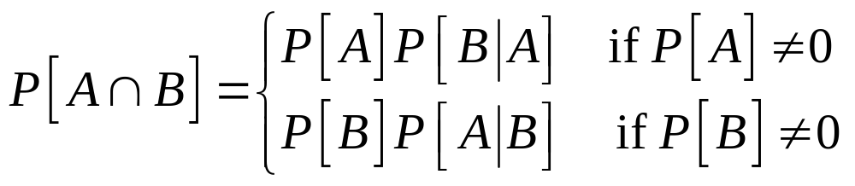
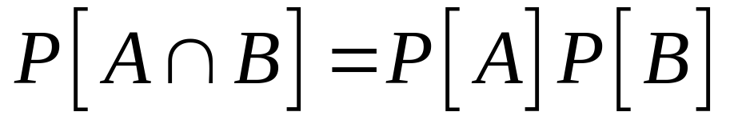
The multiplicative rule of probability
and
if A and B are independent.

Slide 53
Probability
Models for random phenomena

Slide 54
The sample Space, S
The sample space, S, for a random phenomena is the set of all possible outcomes.

Slide 55
An Event , E
The event, E, is any subset of the sample space, S. i.e. any set of outcomes (not necessarily all outcomes) of the random phenomena
Venn diagram
S
E

Slide 56
Definition: probability of an Event E.
Suppose that the sample space S = {o₁, o₂, o₃, … o_{N}} has a finite number, N, of oucomes.
Also each of the outcomes is equally likely (because of symmetry).
Then for any event E

Slide 57
Thus this definition of P[E], i.e.
Applies only to the special case when
The sample space has a finite no.of outcomes, and
Each outcome is equi-probable
If this is not true a more general definition of probability is required.

Slide 58
Summary of the Rules of Probability

Slide 59
The additive rule
P[A ∪ B] = P[A] + P[B] – P[A ∩ B]
and
if A ∩ B = φ
P[A ∪ B] = P[A] + P[B]

Slide 60
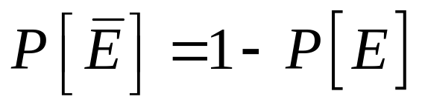
The Rule for complements
for any event E

Slide 61
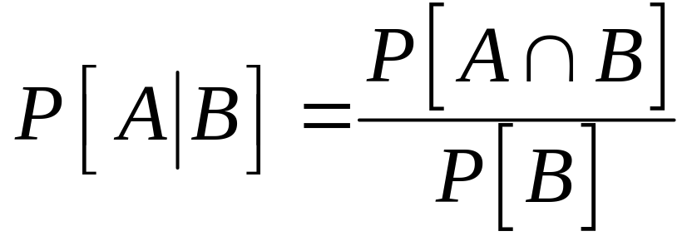
Conditional probability

Slide 62
The multiplicative rule of probability
and
if A and B are independent.
This is the definition of independent

Slide 63
Counting techniques

Slide 64

Finite uniform probability space
Many examples fall into this category
Finite number of outcomes
All outcomes are equally likely
To handle problems in case we have to be able to count. Count n(E) and n(S).

Slide 65
Techniques for counting

Slide 66
Rule 1
Suppose we carry out have a sets A₁, A₂, A₃, … and that any pair are mutually exclusive
(i.e. A₁ ∩ A₂ = φ) Let
n_{i} = n (A_{i}) = the number of elements in A_{i}.
Let A = A₁∪ A₂ ∪ A₃ ∪ ….
Then N = n( A ) = the number of elements in A = n₁ + n₂ + n₃ + …

Slide 67
A₁
A₂
n₁
n₂
A₃
n₃
A₄
n₄

Slide 68
Rule 2
Suppose we carry out two operations in sequence
Let
n₁ = the number of ways the first operation can be performed
n₂ = the number of ways the second operation can be performed once the first operation has been completed.
Then N = n₁ n₂ = the number of ways the two operations can be performed in sequence.

Slide 69




Diagram:

Slide 70
Examples
We have a committee of 10 people. We choose from this committee, a chairman and a vice chairman. How may ways can this be done?
Solution:
Let n₁ = the number of ways the chairman can be chosen = 10.
Let n₂ = the number of ways the vice-chairman can be chosen once the chair has been chosen = 9.
Then N = n₁n₂ = (10)(9) = 90

Slide 71
In Black Jack you are dealt 2 cards. What is the probability that you will be dealt a 21?
Solution:
The number of ways that two cards can be selected from a deck of 52 is N = (52)(51) = 2652.
A “21” can occur if the first card is an ace and the second card is a face card or a ten {10, J, Q, K} or the first card is a face card or a ten and the second card is an ace.
The number of such hands is (4)(16) +(16)(4) =128
Thus the probability of a “21” = 128/2652 = 32/663

Slide 72
The Multiplicative Rule of Counting
Suppose we carry out k operations in sequence
Let
n₁ = the number of ways the first operation can be performed
n_{i} = the number of ways the i^{th} operation can be performed once the first (i - 1) operations have been completed. i = 2, 3, … , k
Then N = n₁n₂ … n_{k} = the number of ways the k operations can be performed in sequence.

Slide 73


Diagram:
⎧
⎪
⎪
⎨
⎪
⎪
⎩

Slide 74
Examples
Permutations: How many ways can you order n objects
Solution:
Ordering n objects is equivalent to performing n operations in sequence.
Choosing the first object in the sequence (n₁ = n)
2. Choosing the 2nd object in the sequence (n₂ = n -1).
…
k. Choosing the k^{th} object in the sequence (n_{k} = n – k + 1)
…
n. Choosing the n^{th} object in the sequence (n_{n} = 1)
The total number of ways this can be done is:
N = n(n – 1)…(n – k + 1)…(3)(2)(1) = n!

Slide 75
  Example How many ways can you order the 4 objects
  {A, B, C, D}
Solution:
N = 4! = 4(3)(2)(1) = 24
Here are the orderings.
ABCD | ABDC | ACBD | ACDB | ADBC | ADCB
BACD | BADC | BCAD | BCDA | BDAC | BDCA
CABD | CADB | CBAD | CBDA | CDAB | CDBA
DABC | DACB | DBAC | DBCA | DCAB | DCBA

Slide 76
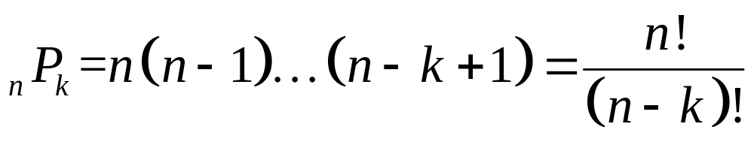
Examples - continued
Permutations of size k (< n): How many ways can you choose k objects from n objects in a specific order
Solution:This operation is equivalent to performing k operations in sequence.
Choosing the first object in the sequence (n₁ = n)
2. Choosing the 2nd object in the sequence (n₂ = n -1).
…
k. Choosing the k^{th} object in the sequence (n_{k} = n – k + 1)
The total number of ways this can be done is:
N = n(n – 1)…(n – k + 1) = n!/ (n – k)!
This number is denoted by the symbol

Slide 77
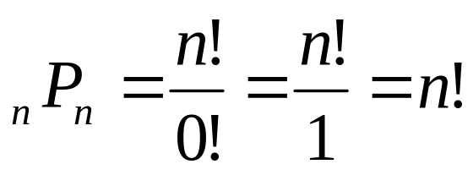
Definition: 0! = 1
This definition is consistent with
for k = n

Slide 78
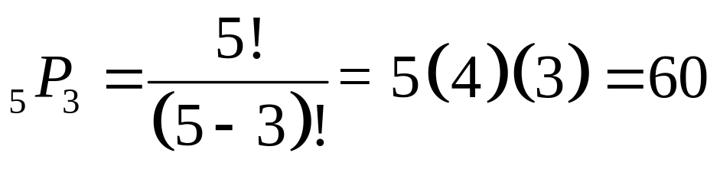
  Example How many permutations of size 3 can be found in the group of 5 objects {A, B, C, D, E}
Solution:
ABC | ABD | ABE | ACD | ACE | ADE | BCD | BCE | BDE | CDE
ACB | ADB | AEB | ADC | AEC | AED | BDC | BEC | BED | CED
BAC | BAD | BAE | CAD | CAE | DAE | CBD | CBE | DBE | DCE
BCA | BDA | BEA | CDA | CEA | DEA | CDB | CEB | DEB | DEC
CAB | DAB | EAB | DAC | EAC | EAD | DBC | EBC | EBD | ECD
CAB | DBA | EBA | DCA | ECA | EDA | DCB | ECB | EDB | EDC

Slide 79
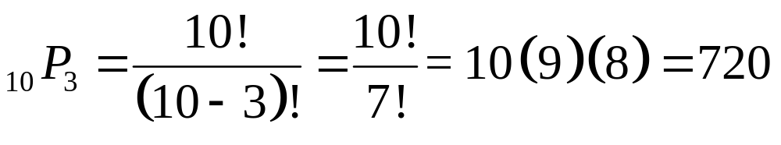
  Example We have a committee of n = 10 people and we want to choose a chairperson, a vice-chairperson and a treasurer
Solution: Essentually we want to select 3 persons from the committee of 10 in a specific order. (Permutations of size 3 from a group of 10).

Slide 80
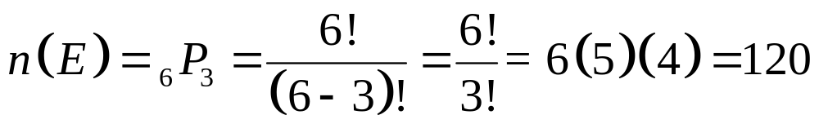
Example We have a committee of n = 10 people and we want to choose a chairperson, a vice-chairperson and a treasurer. Suppose that 6 of the members of the committee are male and 4 of the members are female. What is the probability that the three executives selected are all male?
Solution: Again we want to select 3 persons from the committee of 10 in a specific order. (Permutations of size 3 from a group of 10).The total number of ways that this can be done is:
This is the size, N = n(S), of the sample space S. Assume all outcomes in the sample space are equally likely.
Let E be the event that all three executives are male

Slide 81
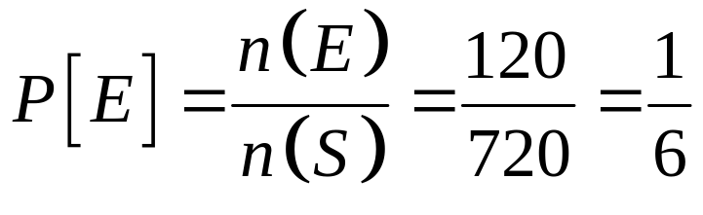

Hence
Thus if all candidates are equally likely to be selected to any position on the executive then the probability of selecting an all male executive is:

Slide 82
Examples - continued
Combinations of size k ( ≤ n): A combination of size k chosen from n objects is a subset of size k where the order of selection is irrelevant. How many ways can you choose a combination of size k objects from n objects (order of selection is irrelevant)
Here are the combinations of size 3 selected from the 5 objects {A, B, C, D, E}
{A,B,C} | {A,B,D} | { A,B,E} | {A,C,D} | {A,C,E}
{A,D,E} | {B,C,D} | {B,C,E} | {B,D,E} | {C,D,E}

Slide 83
Important Notes
In combinations ordering is irrelevant. Different orderings result in the same combination.
In permutations order is relevant. Different orderings result in the different permutations.

Slide 84
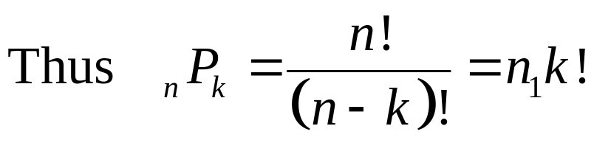
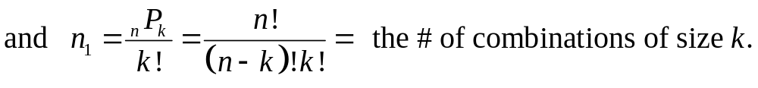
How many ways can you choose a combination of size k objects from n objects (order of selection is irrelevant)
Solution: Let n₁ denote the number of combinations of size k. One can construct a permutation of size k by:
Choosing a combination of size k (n₁ = unknown)
2. Ordering the elements of the combination to form a permutation (n₂ = k!)

Slide 85
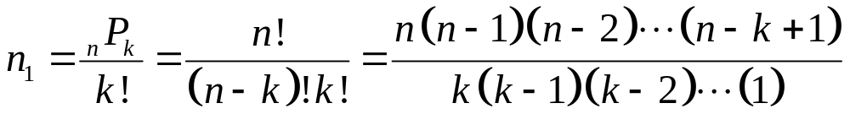
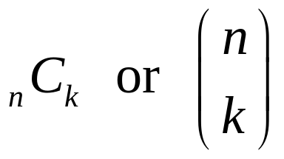
The number:
is denoted by the symbol
read “n choose k”
It is the number of ways of choosing k objects from n objects (order of selection irrelevant).
_{n}C_{k} is also called a binomial coefficient.
It arises when we expand (x + y)^{n} (the binomial theorem)

Slide 86
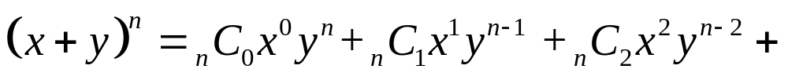
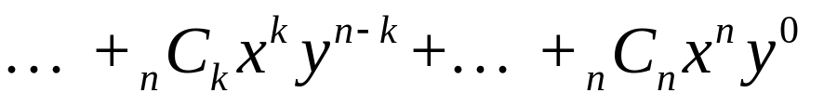
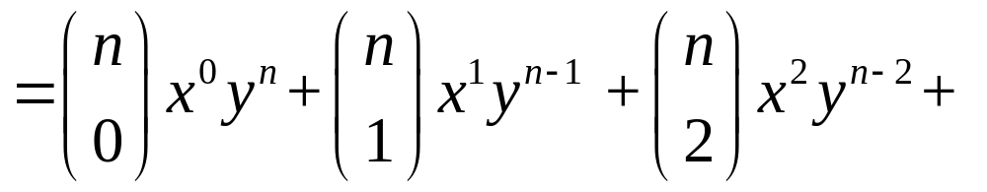
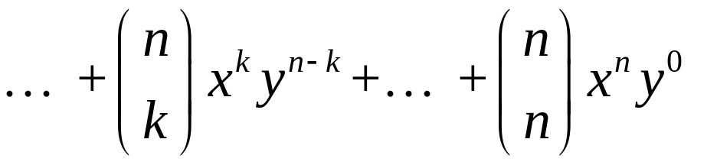
The Binomial theorem:

Slide 87
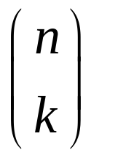
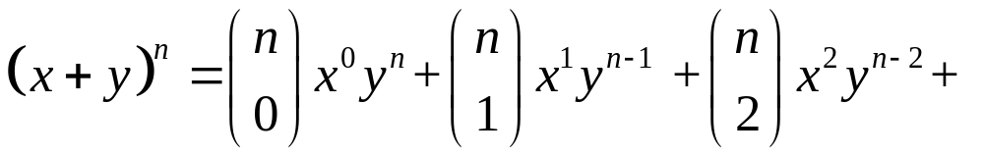
Proof: The term x^{k}y^{n - k} will arise when we select x from k of the factors of (x + y)^{n} and select y from the remaining n – k factors. The no. of ways that this can be done is:
Hence there will be terms equal to x^{k}y^{n = k} and

Slide 88
Pascal’s triangle – a procedure for calculating binomial coefficients
1
1
1
1 2 1
1 3 3 1
1 4 6 4 1
1 5 10 10 5 1
1 6 15 20 15 6 1
1 7 21 35 35 21 7 1

Slide 89
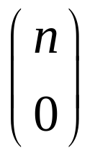
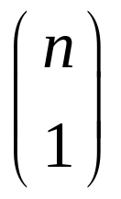
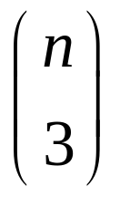
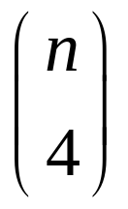
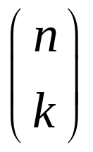
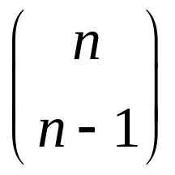
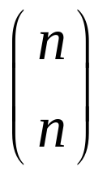

The two edges of Pascal’s triangle contain 1’s
The interior entries are the sum of the two nearest entries in the row above
The entries in the n^{th} row of Pascals triangle are the values of the binomial coefficients

Slide 90







Pascal’s triangle
1
1
1
1 2 1
1 3 3 1
1 4 6 4 1
1 5 10 10 5 1
1 6 15 20 15 6 1
1 7 21 35 35 21 7 1

Slide 91
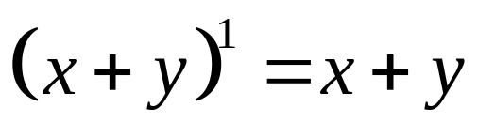
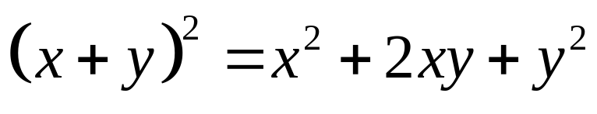
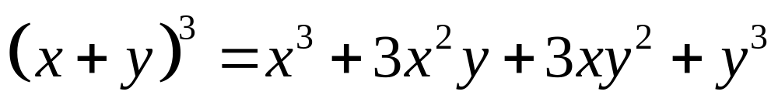
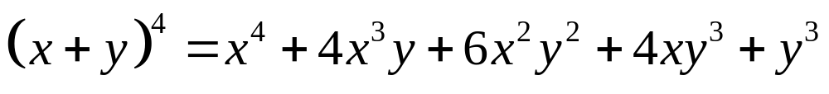
The Binomial Theorem

Slide 92
Summary of counting rules
Rule 1
n(A₁ ∪ A₂ ∪ A₃ ∪ …. ) = n(A₁) + n(A₂) + n(A₃) + …
if the sets A₁, A₂, A₃, … are pairwise mutually exclusive
(i.e. A_{i} ∩ A_{j} = φ)
Rule 2
N = n₁ n₂ = the number of ways that two operations can be performed in sequence if
n₁ = the number of ways the first operation can be performed
n₂ = the number of ways the second operation can be performed once the first operation has been completed.

Slide 93
Rule 3
N = n₁n₂ … n_{k}
= the number of ways the k operations can be performed in sequence if
n₁ = the number of ways the first operation can be performed
n_{i} = the number of ways the i^{th} operation can be performed once the first (i - 1) operations have been completed. i = 2, 3, … , k

Slide 94
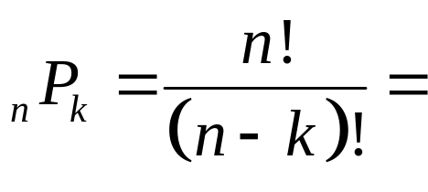

Basic counting formulae
Orderings
Permutations
The number of ways that you can choose k objects from n in a specific order
Combinations
The number of ways that you can choose k objects from n (order of selection irrelevant)

Slide 95
Applications to some counting problems
The trick is to use the basic counting formulae together with the Rules
We will illustrate this with examples
Counting problems are not easy. The more practice better the techniques

Slide 96


Application to Lotto 6/49
Here you choose 6 numbers from the integers 1, 2, 3, …, 47, 48, 49.
Six winning numbers are chosen together with a bonus number.
How many choices for the 6 winning numbers

Slide 97
You can lose and win in several ways
No winning numbers – lose
One winning number – lose
Two winning numbers - lose
Two + bonus – win $5.00
Three winning numbers – win $10.00
Four winning numbers – win approx. $80.00
5 winning numbers – win approx. $2,500.00
5 winning numbers + bonus – win approx. $100,000.00
6 winning numbers – win approx. $4,000,000.00

Slide 98


Counting the possibilities
No winning numbers – lose
All six of your numbers have to be chosen from the losing numbers and the bonus.
One winning numbers – lose
One number is chosen from the six winning numbers and the remaining five have to be chosen from the losing numbers and the bonus.

Slide 99


Two winning numbers – lose
Two numbers are chosen from the six winning numbers and the remaining four have to be chosen from the losing numbers (bonus not included)
Two winning numbers + the bonus – win $5.00
Two numbers are chosen from the six winning numbers, the bonus number is chose and the remaining three have to be chosen from the losing numbers.

Slide 100


Three winning numbers – win $10.00
Three numbers are chosen from the six winning numbers and the remaining three have to be chosen from the losing numbers + the bonus number
four winning numbers – win approx. $80.00
Four numbers are chosen from the six winning numbers and the remaining two have to be chosen from the losing numbers + the bonus number

Slide 101


five winning numbers (no bonus) – win approx. $2,500.00
Five numbers are chosen from the six winning numbers and the remaining number has to be chosen from the losing numbers (excluding the bonus number)
five winning numbers + bonus – win approx. $100,000.00
Five numbers are chosen from the six winning numbers and the remaining number is chosen to be the bonus number

Slide 102

six winning numbers (no bonus) – win approx. $4,000,000.00
Six numbers are chosen from the six winning numbers,

Slide 103

Summary

Slide 104
Summary of counting rules
Rule 1
n(A₁ ∪ A₂ ∪ A₃ ∪ …. ) = n(A₁) + n(A₂) + n(A₃) + …
if the sets A₁, A₂, A₃, … are pairwise mutually exclusive
(i.e. A_{i} ∩ A_{j} = φ)
Rule 2
N = n₁ n₂ = the number of ways that two operations can be performed in sequence if
n₁ = the number of ways the first operation can be performed
n₂ = the number of ways the second operation can be performed once the first operation has been completed.

Slide 105
Rule 3
N = n₁n₂ … n_{k}
= the number of ways the k operations can be performed in sequence if
n₁ = the number of ways the first operation can be performed
n_{i} = the number of ways the i^{th} operation can be performed once the first (i - 1) operations have been completed. i = 2, 3, … , k

Slide 106
Basic counting formulae
Orderings
Permutations
The number of ways that you can choose k objects from n in a specific order
Combinations
The number of ways that you can choose k objects from n (order of selection irrelevant)

Slide 107
Applications to some counting problems
The trick is to use the basic counting formulae together with the Rules
We will illustrate this with examples
Counting problems are not easy. The more practice better the techniques

Slide 108


Another Example counting poker hands
A poker hand consists of five cards chosen at random from a deck of 52 cards.
The total number of poker hands is

Slide 109
Types of poker hand counting poker hands
Nothing Hand {x, y, z, u, v}
  Not all in sequence or not all the same suit
Pair {x, x, y, z, u}
Two pair {x, x, y, y, z}
Three of a kind {x, x, x, y, z}
Straight {x, x+ 1, x + 2, x + 3, x + 4}
  5 cards in sequence
  Not all the same suit
Flush {x, y, z, u, v}
  Not all in sequence but all the same suit

Slide 110
Full House {x, x, x, y, y}
Four of a kind {x, x, x, x, y}
Straight Flush {x, x+ 1, x + 2, x + 3, x + 4}
  5 cards in sequence but not {10, J, Q, K, A}
  all the same suit
Royal Flush {10, J, Q, K, A}
  all the same suit

Slide 111






counting the hands
Pair {x, x, y, z, u}
We have to:
Choose the value of x
Select the suits for the for x.
Choose the denominations {y, z, u}
Choose the suits for {y, z, u} - 4×4×4 = 64
Total # of hands of this type = 13 × 6 × 220 × 64 = 1,098,240
Two pair {x, x, y, y, z}
We have to:
Choose the values of x, y
Select the suits for the for x and y.
Choose the denomination z
Choose the suit for z - 4
Total # of hands of this type = 78 × 36 × 11 × 4 = 123,552

Slide 112




Three of a kind {x, x, x, y, z}
We have to:
Choose the value of x
Select the suits for the for x.
Choose the denominations {y, z}
Choose the suits for {y, z} - 4×4 = 16
Total # of hands of this type = 13 × 4 × 66 × 16 = 54,912
Full House {x, x, x, y, y}
We have to:
Choose the value of x then y
Select the suits for the for x.
Select the suits for the for y.
Total # of hands of this type = 156 × 4 × 6 = 3,696

Slide 113


Four of a kind {x, x, x, x, y}
We have to:
Choose the value of x
Select the suits for the for x.
Choose the denomination of y.
Choose the suit for y - 4
Total # of hands of this type = 13 × 1 × 12 × 4 = 624
Royal Flush {10, J, Q, K, A}
  all the same suit
Total # of hands of this type = 4 (no. of suits)
Straight Flush {x, x+ 1, x + 2, x + 3, x + 4}
  5 cards in sequence but not {10, J, Q, K, A}
  all the same suit
Total # of hands of this type = 9×4 = 36 (no. of suits)
The hand could start with {A, 2, 3, 4, 5, 6, 7, 8, 9}

Slide 114
Straight {x, x+ 1, x + 2, x + 3, x + 4}
  5 cards in sequence
  Not all the same suit
We have to:
Choose the starting value of the sequence, x.
Total of 10 possibilities {A, 2, 3, 4, 5, 6, 7, 8, 9, 10}
Choose the suit for each card
4 × 4 × 4 × 4 × 4 = 1024
Total # of hands of this type = 1024 × 10 - 36 - 4 = 10200
We would have also counted straight flushes and royal flushes that have to be removed

Slide 115

Flush {x, y, z, u, v}
  Not all in sequence but all the same suit
We have to:
Choose the suit 4 choices
Choose the denominations {x, y, z, u, v}
Total # of hands of this type = 1287 × 4 - 36 - 4 = 5108
We would have also counted straight flushes and royal flushes that have to be removed

Slide 116

Summary

Slide 117
Quick summary of probability

